Slide 1

Power BI Desktop Data Preparation

Slide 2
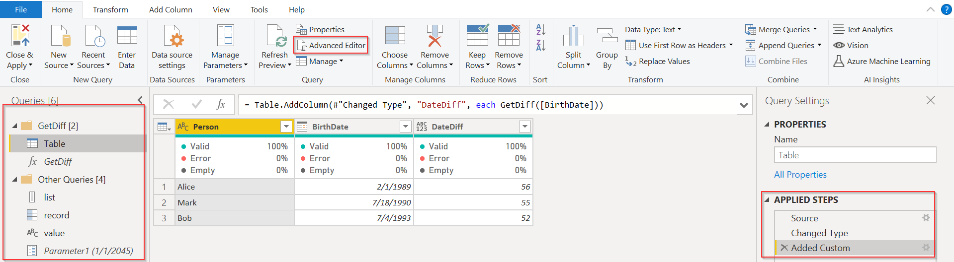
Power Query Editor Overview
Power query editor
Power Query objects overview
Queries | Steps | Advanced Editor
Table | List | Record | Value | Parameter

Slide 3
Data extraction

Slide 4
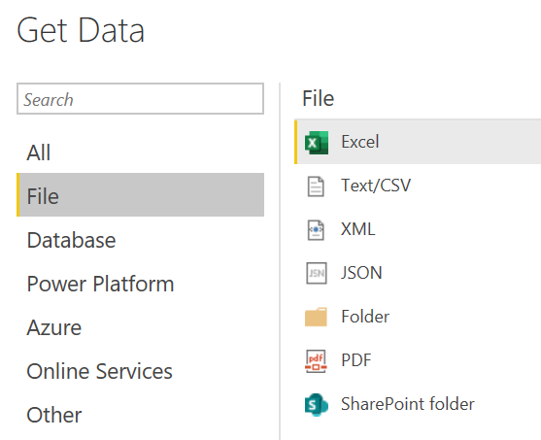
Data extraction
Files
Along with file connections, manual data entering is another one option to bring data to Power BI.
Connections we are going to cover:
Excel
Text/CSV
Folder
PDF

Slide 5
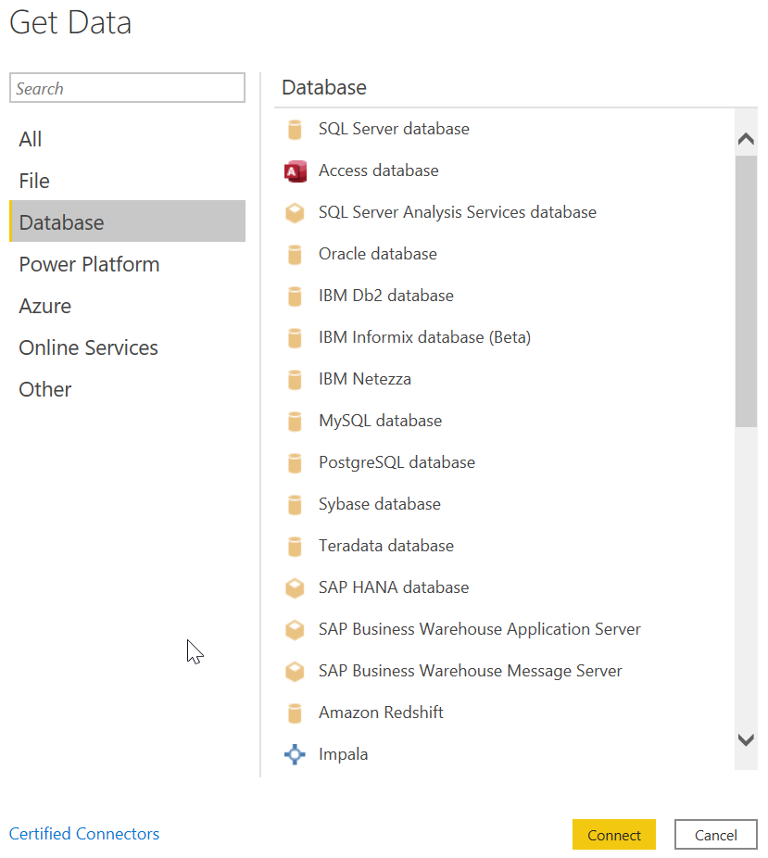
Data extraction
Databases
Connections we are going to cover: PostgreSQL database
Differences between Import mode and Direct Query:
Import: The selected tables and columns are imported into Power BI Desktop. As you create or interact with a visualization, Power BI Desktop uses the imported data. To see underlying data changes since the initial import or the most recent refresh, you must refresh the data, which imports the full dataset again.
DirectQuery (Live Connection): No data is imported or copied into Power BI Desktop. For relational sources, the selected tables and columns appear in the Fields list. For multi-dimensional sources like SAP Business Warehouse, the dimensions and measures of the selected cube appear in the Fields list. As you create or interact with a visualization, Power BI Desktop queries the underlying data source, so you’re always viewing current data.
https://docs.microsoft.com/en-us/power-bi/connect-data/desktop-use-directquery

Slide 6
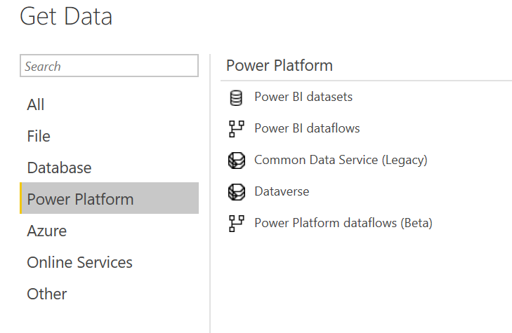
Data extraction
Power Platform
Connections we are going to cover:
Power BI datasets

Slide 7
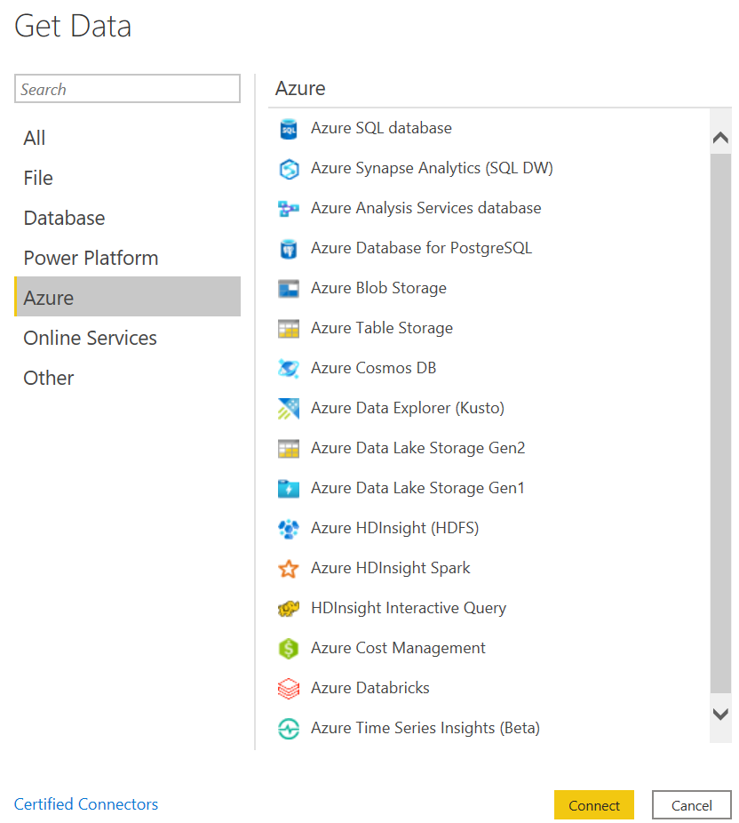
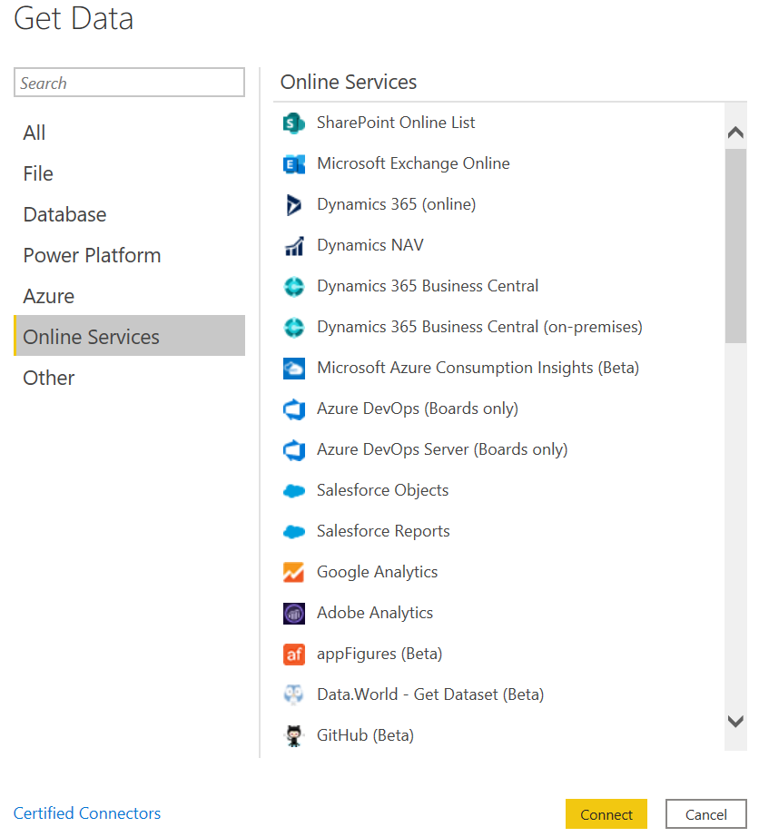
Data extraction
Azure
Online services

Slide 8
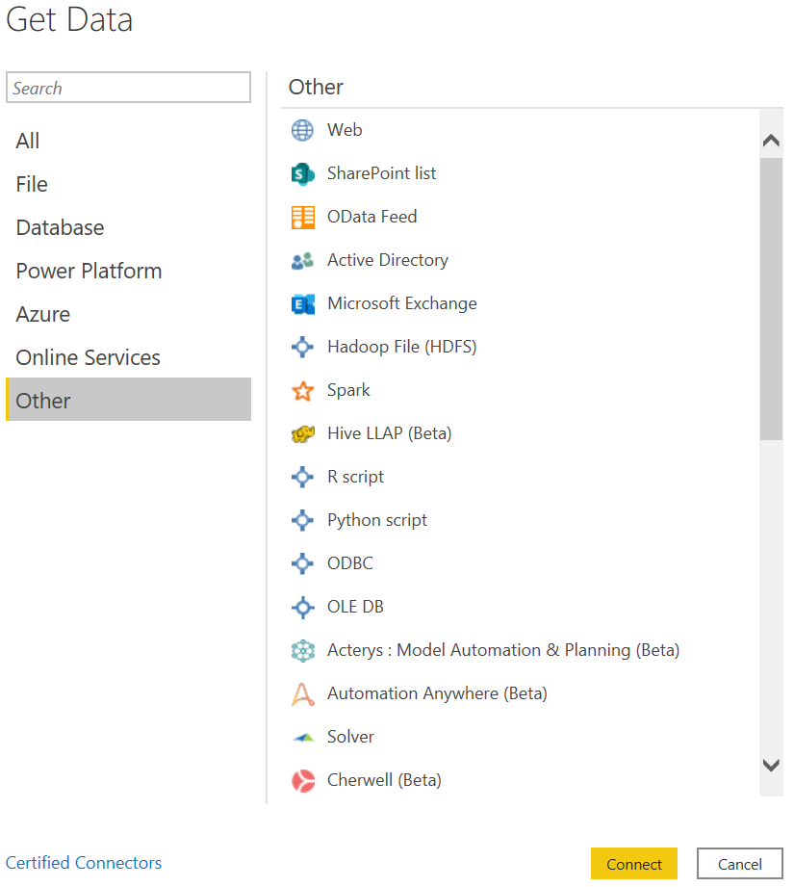
Data extraction
OTHER
Connections we are going to cover:
Web
OData Feed

Slide 9
Data transformation

Slide 10
Cleaning data
Cleaning options
Promote headers
Change data types
Rename columns
Remove columns
Reorder columns
Duplicate columns
Split fields
Merge fields
Clean field (trim, delete unprinted characters, capitalize, etc.)
Numerical transformations
Remove and replace values
Filter values
Remove duplicates
Etc.

Slide 11
Transforming data
Transformation options
Query Joining options
Group data
Pivot data
Unpivot data
Transpose data
Merge Queries
Append Queries

Slide 12
Data Enrichment
Data Enrichment options
Custom columns & Power Query M Functions overview
Conditional columns
Index column
Filling columns (up, down)
Invoke custom function
All the Power Query M functions are case sensitive! Text.From <> text.from

Slide 13
Loading and refreshing data

Slide 14
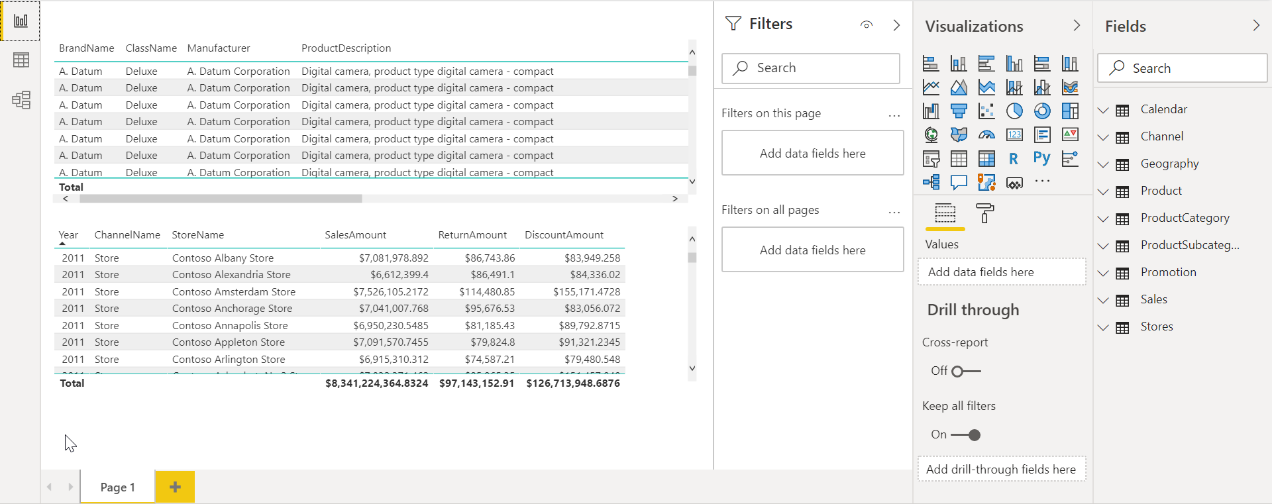
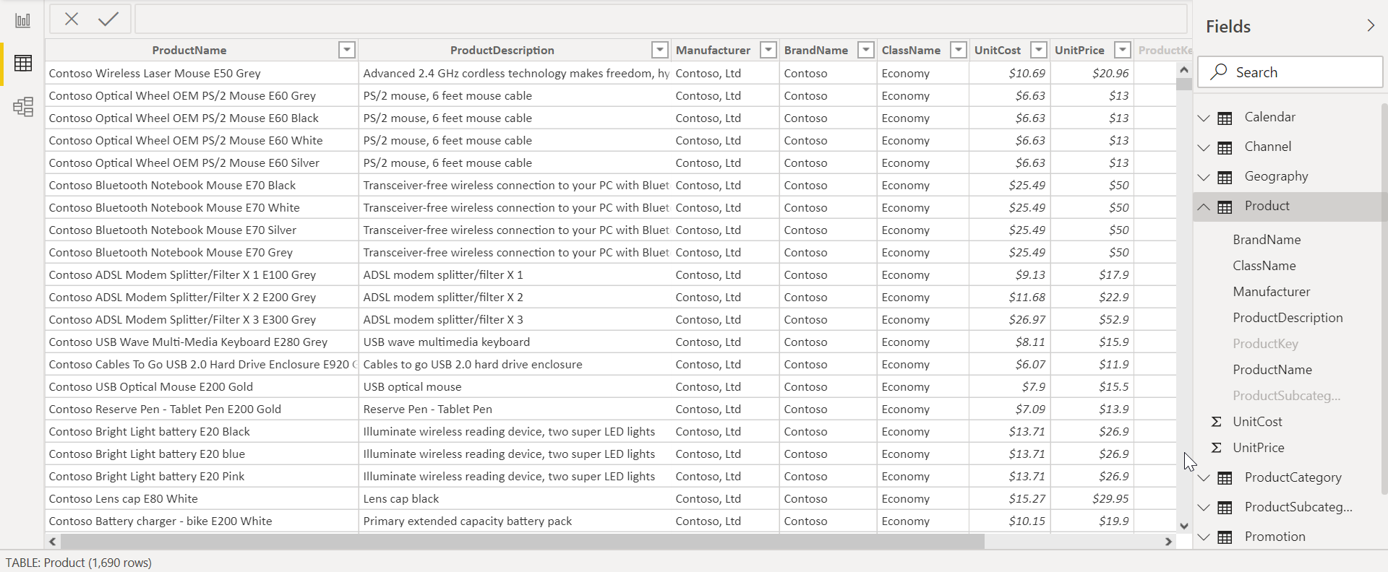
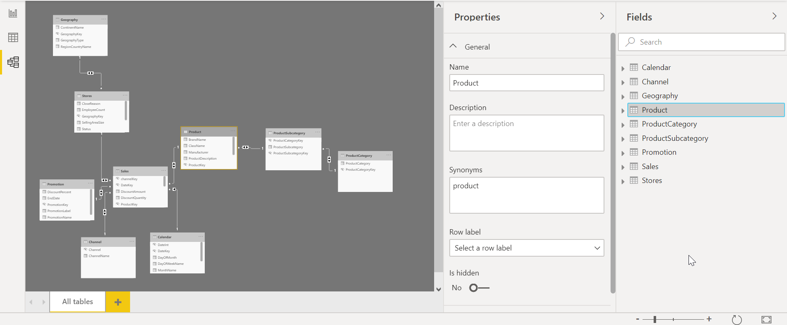
Loading and Refreshing Data
Report, Data and Model tabs
Report tab
Create pages
Add visualizations
Work with filters
Manage fields
Data tab
Explore data
See rows count, distinct information
Manage fields
Model tab
Manage tables
Manage relationships
Manage fields

Slide 15
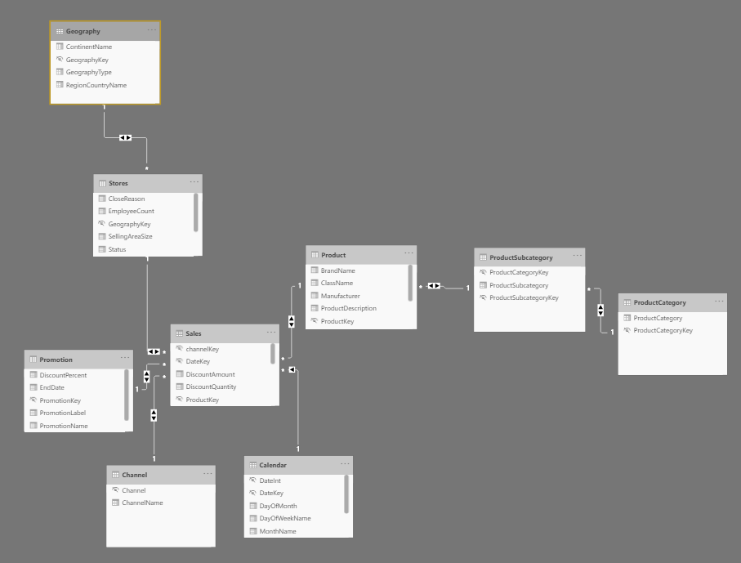
Loading and Refreshing Data
Relationships
Relationships are autodetected during data load
Options:
Cardinality
Many to one (*:1)
One to one (1:1)
One to many (1:*)
Many to many (*:*)
Cross filter direction
Single
Both
Make this relationship active/inactive
More information about relationships

Slide 16
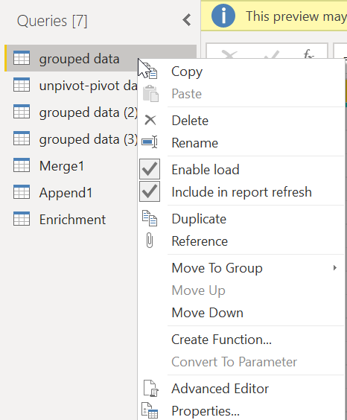
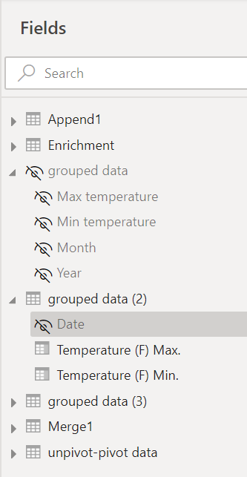
Loading and Refreshing Data
Loading data
Enable Load option
Include in report refresh option
Hide table
Hide field
Change Data Source settings

Slide 17
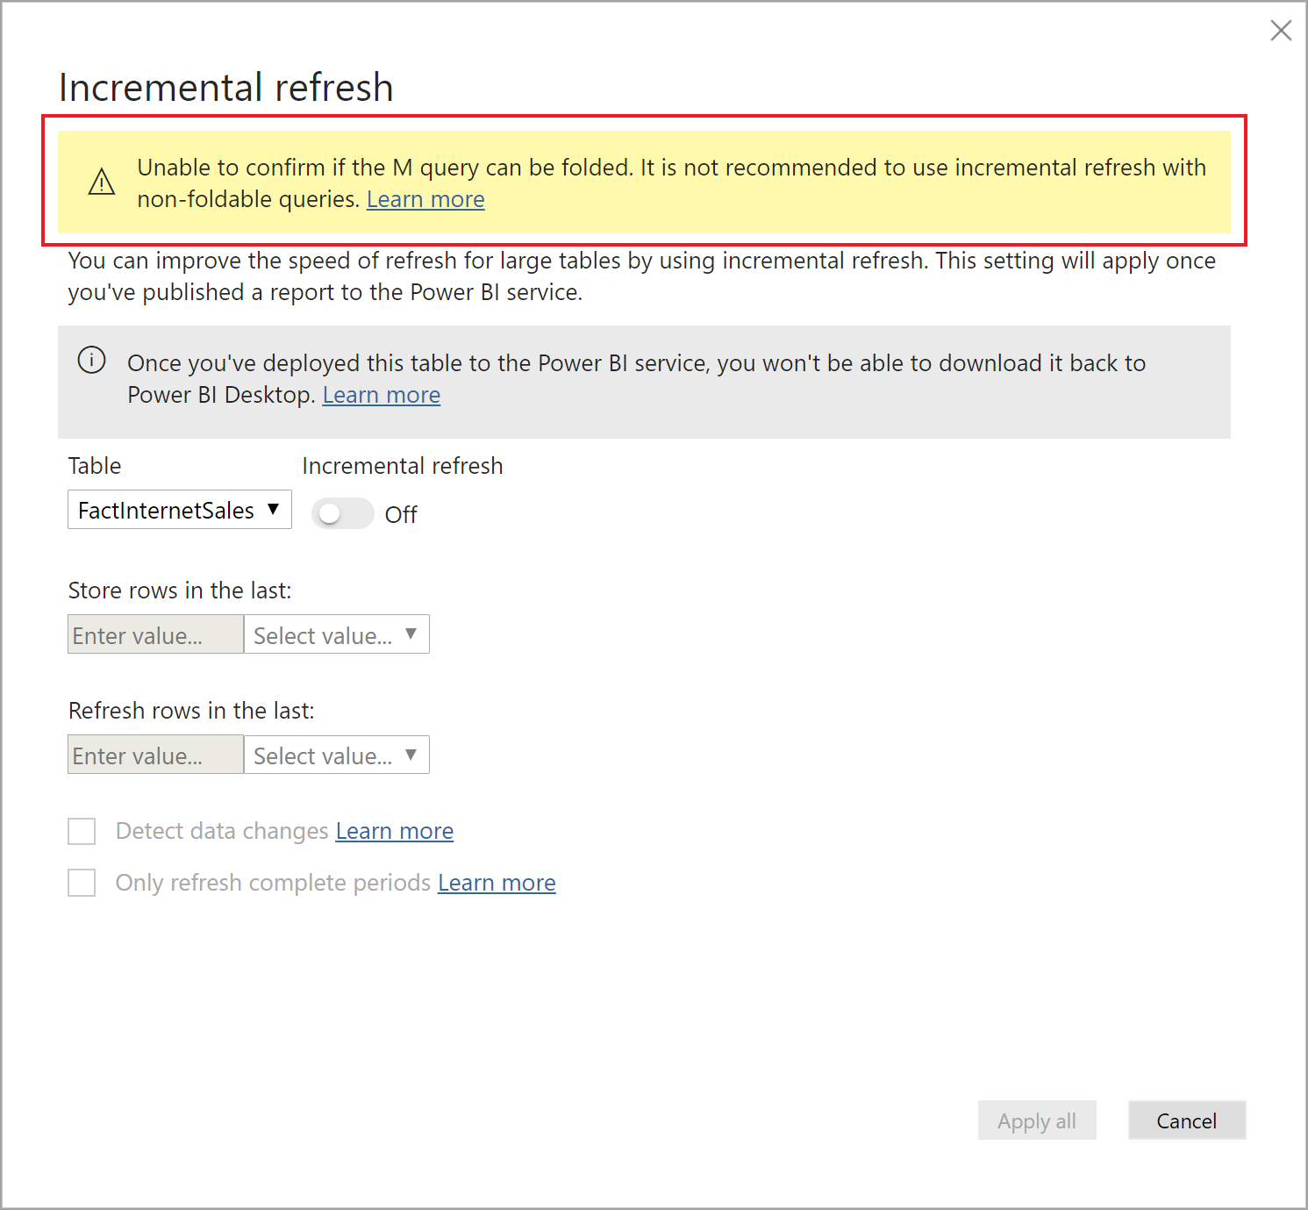
Loading and Refreshing Data
Incremental refresh
Incremental refresh policies are defined in Power BI Desktop and applied when published to the Power BI service.
Setting up Incremental Refresh steps:
Add RangeStart and RangeEnd parameters to the report
Define refresh policy at table level
Publish .pbix report to the Power BI Service. First refresh will load historical data, subsequent refreshes will load increment
More details about incremental refresh

